Slide 1


Fundamentals of Testing
ISTQB Certification Program
Seven Testing Principles

Slide 2

Seven Testing Principles
Test Process
Q&A
Agenda

Slide 3
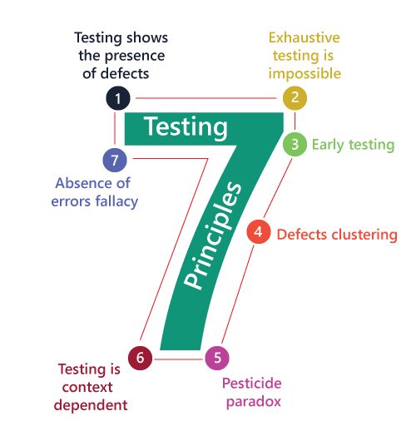
7 Testing Principles

Slide 4

1
Testing shows the presence of defects,
not their absence
We can only detect errors
where we are testing

Slide 5
Exhaustive testing is impossible
2
Test Case 1
Test Case 10
Test Case 100
Test Case 1000
Test Case 1 000 000
1
2
3
4
5
Test 100% of scenarios is impossible

Slide 6
Early testing saves time and money
3

Slide 7
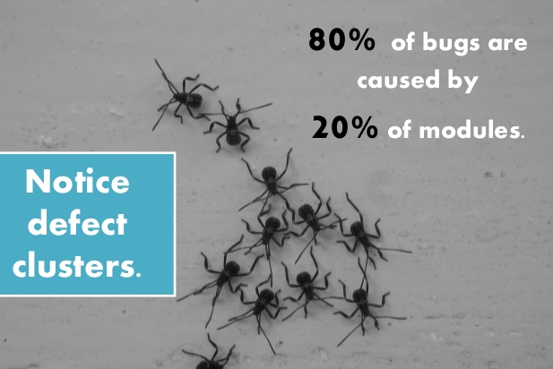
Defects cluster together
4

Slide 8

Pesticide paradox
5
If the same tests are repeated over and over again, eventually they will no longer find any new defects

Slide 9


Testing is context dependent
6
VS
Safety-critical industrial control software is tested differently from an e-commerce mobile app

Slide 10

Absence of errors is a fallacy
7
We can not guarantee a software is 100% Bug Free

Slide 11
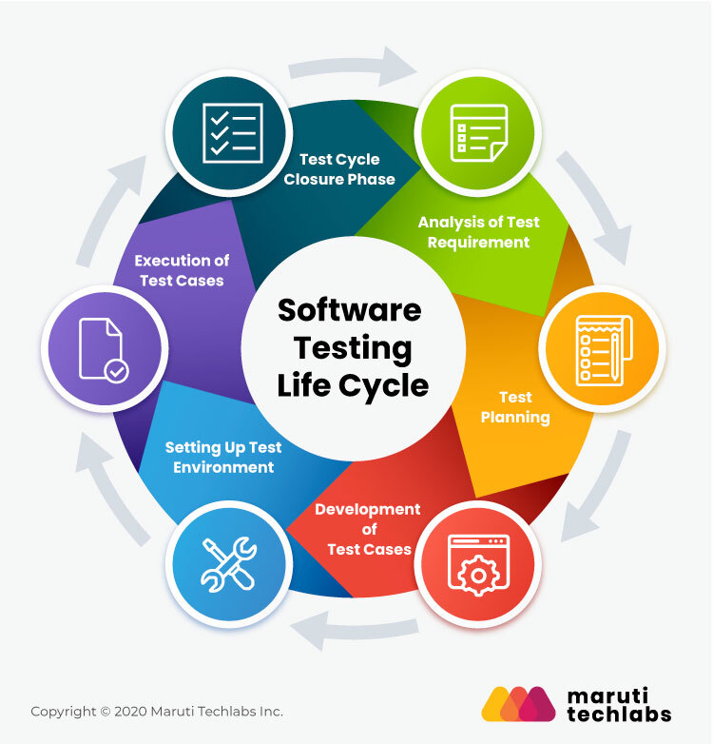
Test Process

Slide 12
Factors that influence the test process
Software development lifecycle model and project methodologies being used
Test levels and test types being considered
Product and project risks
Business domain

Slide 13
Factors that influence the test process
Budgets and resources o Timescales o Complexity o Contractual and regulatory requirements
Organizational policies and practices
Required internal and external standards

Slide 14
Test Activities
Test planning
Test monitoring and control
Test analysis
Test design
Test implementation
Test execution
Test completion

Slide 15


The Psychology of Testing

Slide 16
Q & E

